Slide 1
AngularJS - Session 1
Stepping IN

Slide 2
Why AngularJS
Front-End Applications
Dynamic Applications and Static Documents
Library & frameworks
HTML, CSS, DOM
Client-side vs Server-side Solutions
Single Page Applications

Slide 3
Prerequisite for Angular JS
HTML
CSS
Type Script
Knowledge on Nodejs and Node package manger
Chrome Dev tools

Slide 4
HTML
Tags
Attributes
Events

Slide 5
HTML – Generally Used Tags
Basic | View | View | Entry | Other
<html> | <h1> to <h6> | <header> <footer> <nav> (Semantic) | <form> | <canvas>
<head> | <div> <p> <span> | <img> | <input> | <iframe>
<body> | <strong> <small> | <audio> | <textarea>
<title> | <b> <i> <s> | <video> | <button>
<!-- --> | <ul> <ol> <li> | <source> <track> | <select>
<script> | <table> <thead> | <abbr> | <option>
<meta> | <th> <tr> <td> | <code> | <label>
<style> | <a> | <sup> <sub> | <fieldset>

Slide 6
HTML – Generally Used Attributes
Tag | Attributes | Tag | Attributes
Global | id | Form | action
Global | class | Input | checked
Global | style | Td Th | colspan, rowspan
Input | type=[text, number, password, file, checkbox, radio] | Label | for
Button | type=[Submit, Reset] | Input Textarea | maxlength
Img, audio, video, script, iframe | src | Textarea | rows, cols, wrap
Img | alt | Global | tabindex, name, title
Button Input Options | value | Col | span

Slide 7
HTML – Generally Used Events
Event | Description
onclick | Fires on a mouse click on the element
onchange | Fires the moment when the value of the element is changed
onsubmit | Fires when a form is submitted
onkeypress | Fires when a user presses a key
onmousedown | Fires when a mouse button is pressed down on an element
onmouseover | Fires when the mouse pointer moves over an element
onmouseout | Fires when the mouse pointer moves out of an element
onscroll | Script to be run when an element's scrollbar is being scrolled

Slide 8
HTML – Generally Used Events
Event | Description
onload | Fires after finished loading
onresize | Fires when the browser window is resized
onfocus | Fires the moment when the element gets focus
onblur | Fires the moment that the element loses focus
onselect | Fires after some text has been selected in an element
ononline onoffline | Script to be run when the browser starts to work online / offline
onerror | Script to be run when an error occurs
onpaste | Fires when the user pastes some content in an element

Slide 9
Learning Resources
https://www.freecodecamp.org/learn/responsive-web-design#basic-html-and-html5
https://www.w3schools.com/html/default.asp
https://youtu.be/UB1O30fR-EE
http://hittochan.blogspot.com/2011/07/tags-in-html5.html

Slide 10

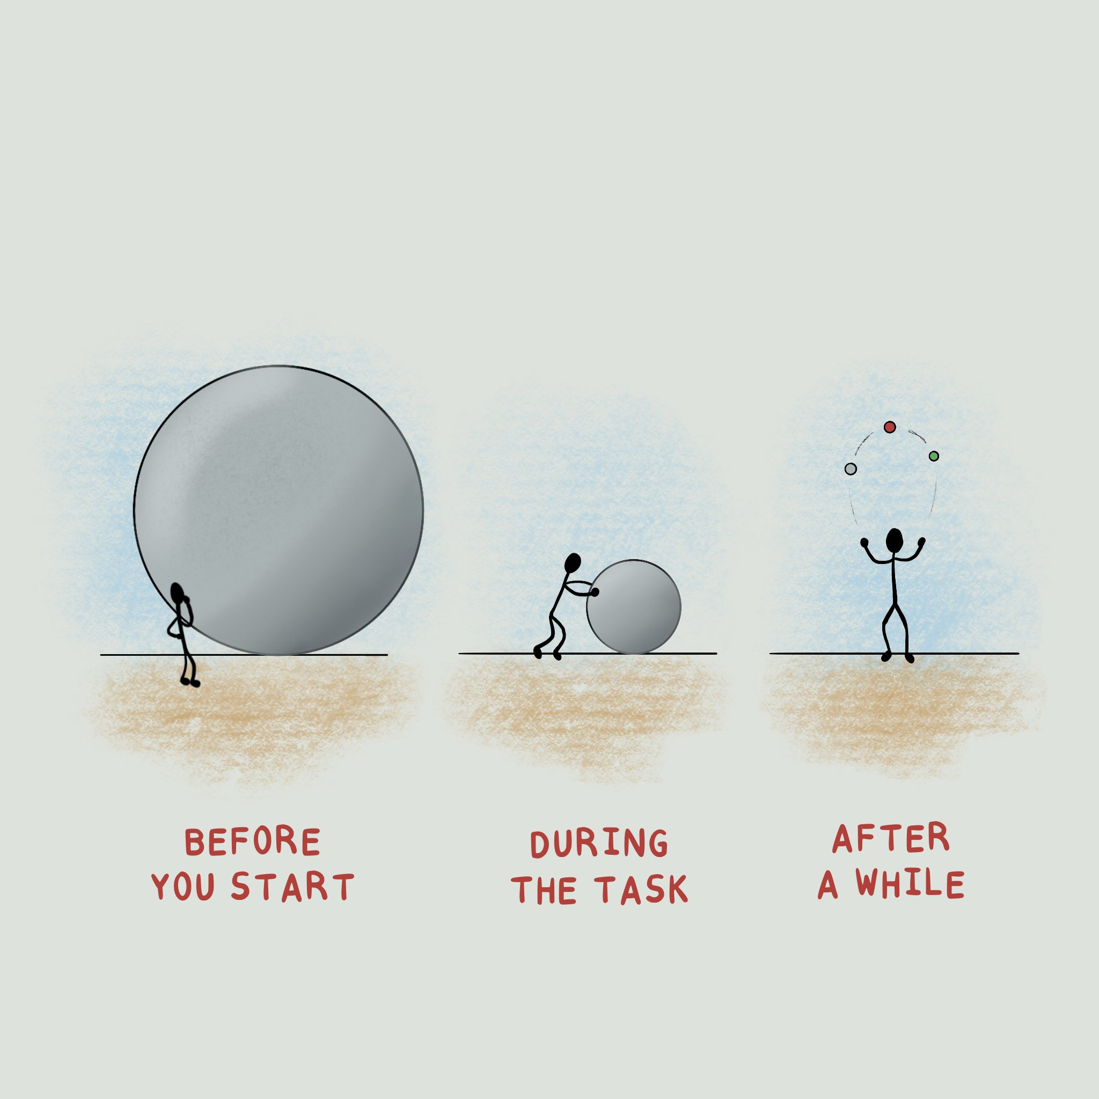
Thank You

